Slide 1
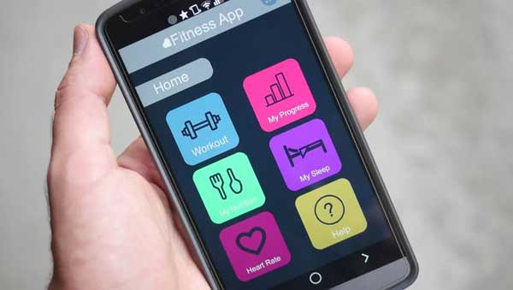
Fitness and Nutrition Buddy
By: Andy Hansana, Vincent Weaver, Ryan Crowley, Kevin Elliott

Slide 2
Key Points
Summary/Overview
Targeted Audience
Purpose of Application
Current Competitors
Conclusion
Questions

Slide 3
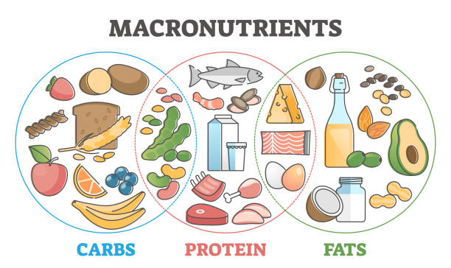
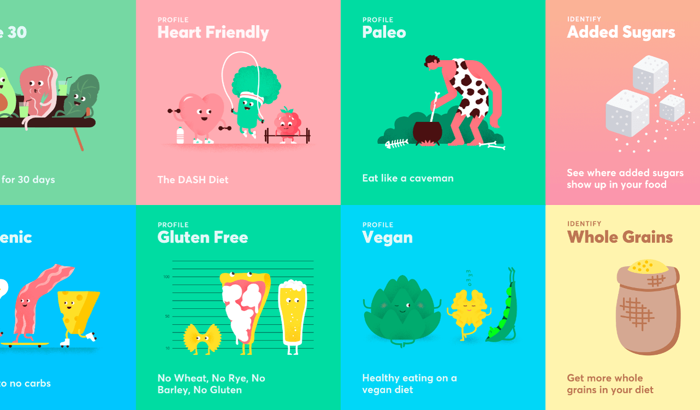
What is it?
Application on mobile devices that creates meals from restaurants based on their diet & keeps track of amount of calories burned.
Users input their personal calorie and macronutrient limits along with their location.
Based on the users location the app will take the surrounding restaurants menus and create a customized meal.
Each meal is custom made to fit a users diet.

Slide 4

Who is it for?
Fitness enthusiasts, those with strict macros for building muscle
Health-conscious individuals, active people regardless of intensity or frequency of workouts
Anyone with health goals in mind, someone who wants to lose weight, or eat healthier

Slide 5

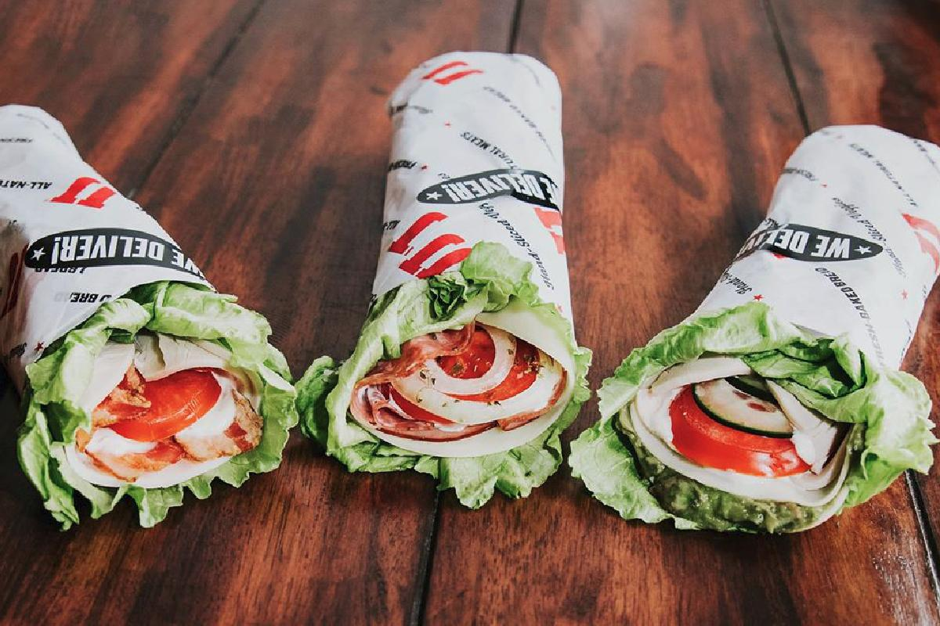
Why would people want it?
On-the go convenience; lets users discover new restaurants and meals in the area
Intuitive step towards achieving fitness goals
Allows for peace of mind while enjoying freshly cooked restaurant meals
Creates healthy alternatives at fast food restaurants
Notes:
R-Dawg

Slide 6
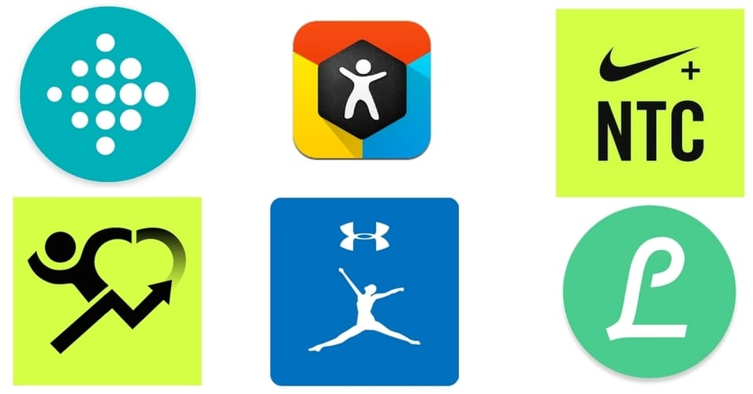
Competitors
MyFitnessPal is it’s leading competitor for fitness & nutrition applications.
Lose It is another popular weight loss app, focusing more on the food than fitness
However, myFitnessPal and Lose It do not provide custom meals for users, just calorie tracking.

Slide 7
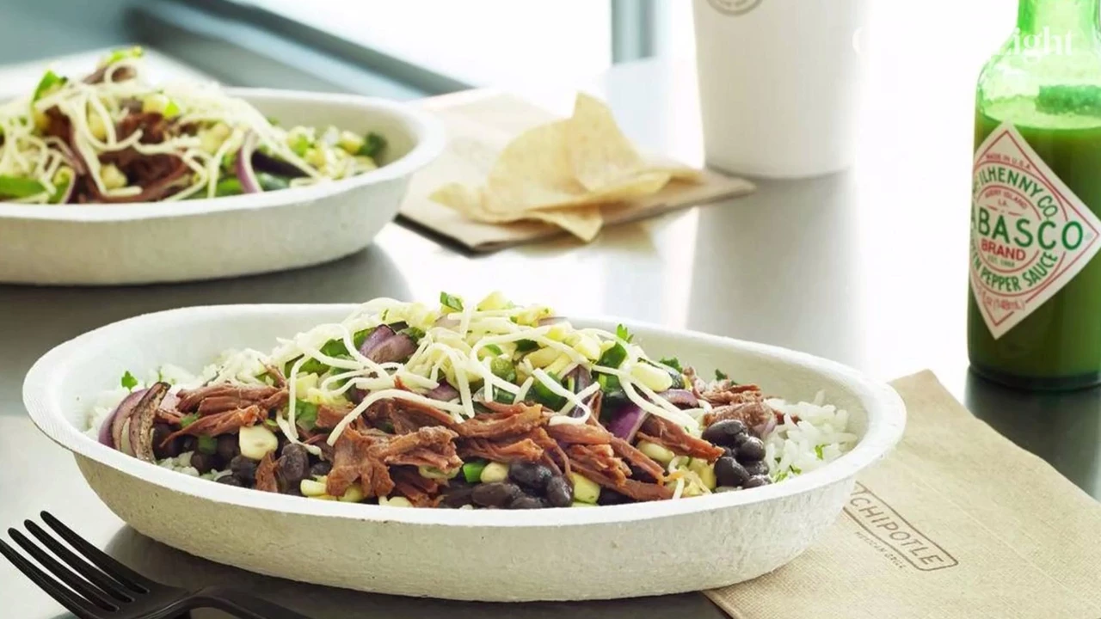
Conclusion
The application is another option for those interested in nutrition but choose to go for takeout/dine-in instead.
The app can be used by anyone from a powerlifter to someone who works out occasionally.
Discover new meals from restaurants, new or old.

Slide 8
Questions?

